Slide 1
Virtual Memory

Slide 2
Introduction
Virtual memory != Virtual address
  Virtual address is address issued by CPU’s execution unit, later converted by MMU to physical address
  Virtual memory is a memory management technique employed by OS (with hardware support, of course)

Slide 3
Unused parts of program
int a[4096][4096]
int f(int m[][4096]) {
int i, j;
for(i = 0; i < 1024; i++)
m[0][i] = 200;
}
int main() {
int i, j;
for(i = 0; i < 1024; i++)
a[1][i] = 200;
if(random() == 10)
f(a);
}
All parts of array a[] not accessed
Function f() may not be called

Slide 4
Some problems with schemes discussed so far
Code needs to be in memory to execute, But entire program rarely used
  Error code, unusual routines, large data structures are rarely used
So, entire program code, data not needed at same time
So, consider ability to execute partially-loaded program
  One Program no longer constrained by limits of physical memory
  One Program and collection of programs could be larger than physical memory

Slide 5
What is virtual memory?
Virtual memory – separation of user logical memory from physical memory
  Only part of the program needs to be in memory for execution
  Logical address space can therefore be much larger than physical address space
  Allows address spaces to be shared by several processes
  Allows for more efficient process creation
  More programs running concurrently
  Less I/O needed to load or swap processes
Virtual memory can be implemented via:
  Demand paging
  Demand segmentation

Slide 6
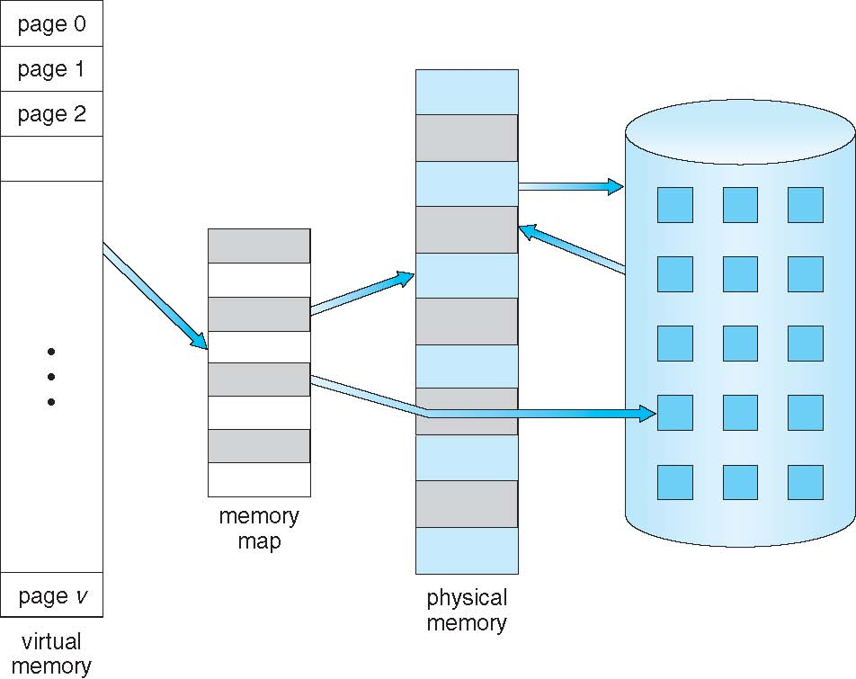
Virtual Memory
Larger
Than
Physical
Memory

Slide 7
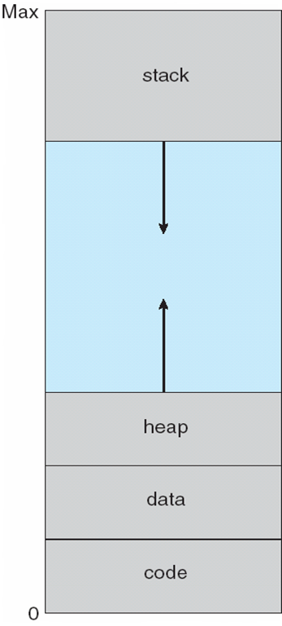
Virtual Address space
Enables sparse address spaces with holes left for growth, dynamically linked libraries, etc

Slide 8
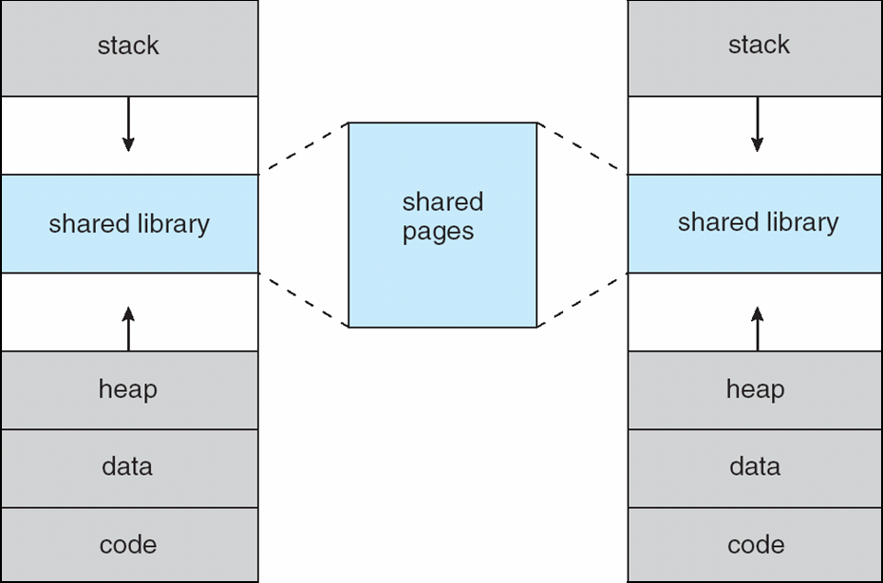
Shared pages
Using Virtual Memory
System libraries shared via mapping into virtual address space
Shared memory by mapping same page-frames into page tables of involved processes
Pages can be shared during fork(), speeding process creation (more later)

Slide 9
Demand Paging

Slide 10
Demand Paging
Load a “page” to memory when it’s neded (on demand)
  Less I/O needed, no unnecessary I/O
  Less memory needed
  Faster response
  More processes

Slide 11
Demand Paging
Options:
  Load entire process at load time : achieves little
  Load some pages at load time: good
  Load no pages at load time: pure demand paging

Slide 12
Demand Paging
Page is needed --> check reference to it
  invalid reference -> abort
  not-in-memory -> bring to memory
Lazy swapper – never swaps a page into memory unless page will be needed
  Swapper that deals with pages is a pager

Slide 13
New meaning for valid/invalid bits in page table
Frame #
valid-invalid bit
v
With each page table entry a valid–invalid bit is associated
  v: in-memory – memory resident
  i : not-in-memory or illegal
During address translation, if valid–invalid bit in page table entry is I : raises trap called page fault
v
v
v
i
….
i
i

Slide 14
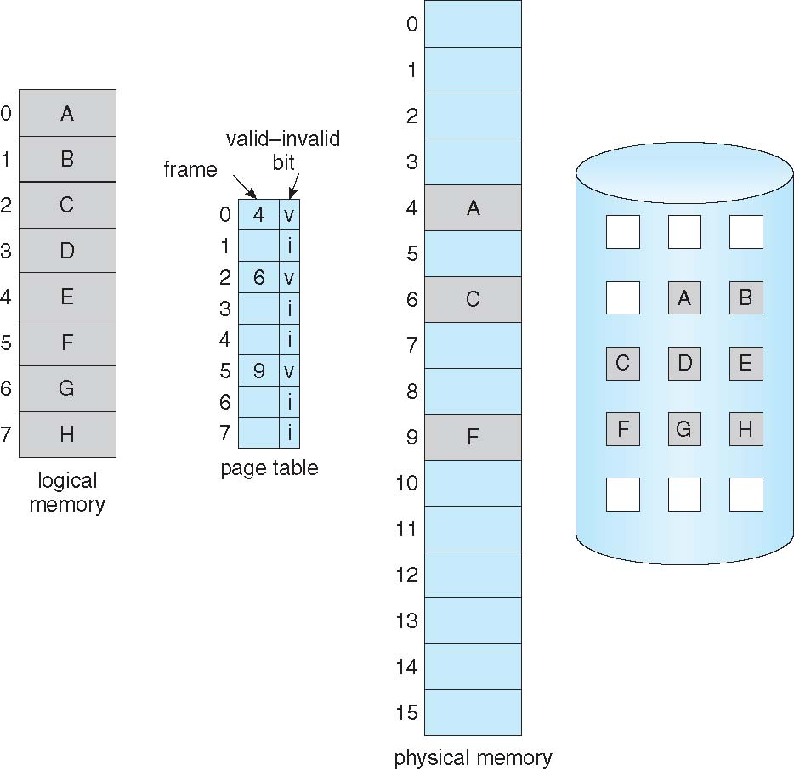
_{Page}
_{Table}
_{With}
_{Some pages}
_{Not}
_{In memory}

Slide 15
Page fault

Slide 16
Page fault
Page fault is a hardware interrupt
It occurs when the page table entry corresponding to current memory access is “i”
All actions that a kernel takes on a hardware interrupt are taken!
  Change of stack to kernel stack
  Saving the context of process
  Switching to kernel code

Slide 17
On a Page fault
Operating system looks at another data structure (table), most likely in PCB itself, to decide:
  If it’s Invalid reference -> abort the process (segfault)
  Just not in memory -> Need to get the page in memory
Get empty frame (this may be complicated!)
Swap page into frame via scheduled disk/IO operation
Reset tables to indicate page now in memory.
Set validation bit = v
Restart the instruction that caused the page fault

Slide 18
Additional problems
Extreme case – start process with no pages in memory
  OS sets instruction pointer to first instruction of process, non-memory-resident -> page fault
  And for every other process pages on first access
  Pure demand paging
Actually, a given instruction could access multiple pages -> multiple page faults
  Pain decreased because of locality of reference
Hardware support needed for demand paging
  Page table with valid / invalid bit
  Secondary memory (swap device with swap space)
  Instruction restart

Slide 19
Instruction restart
A critical Problem
Consider an instruction that could access several different locations
  movarray 0x100, 0x200, 20
  # copy 20 bytes from address 0x100 to address 0x200
  movarray 0x100, 0x110, 20
  # what to do in this case?

Slide 20
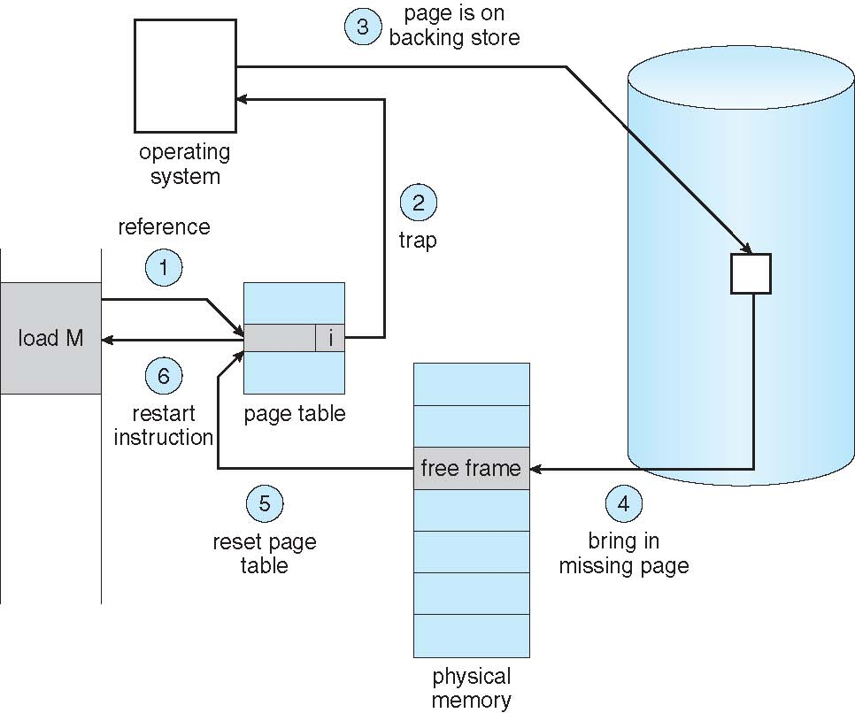
Handling
A
Page
Fault

Slide 21
Page fault handling
Trap to the operating system
Default trap handling():
  Save the process registers and process state
  Determine that the interrupt was a page fault. Run page fault handler.
Page fault handler(): Check that the page reference was legal and determine the location of the page on the disk. If illegal, terminate process.
Find a free frame. Issue a read from the disk to a free frame:
  Process waits in a queue for disk read. Meanwhile many processes may get scheduled.
  Disk DMA hardware transfers data to the free frame and raises interrupt in end

Slide 22
Page fault handling
(as said on last slide) While waiting, allocate the CPU to some other process
(as said on last slide) Receive an interrupt from the disk I/O subsystem (I/O completed)
Default interrupt handling():
  Save the registers and process state for the other process
  Determine that the interrupt was from the disk
Disk interrupt handler():
  Figure out that the interrupt was for our waiting process
  Make the process runnable
Wait for the CPU to be allocated to this process again
  Kernel restores the page table of the process, marks entry as “v”
  Restore the user registers, process state, and new page table, and then resume the interrupted instruction

Slide 23
Performance of demand paging
Page Fault Rate 0 <= p <= 1
if p = 0 no page faults
if p = 1, every reference is a fault
Effective (memory) Access Time (EAT)
EAT = (1 – p) * memory access time +
p * (page fault overhead // Kernel code execution time
+ swap page out // time to write an occupied frame to disk
+ swap page in // time to read data from disk into free frame
+ restart overhead) // time to reset process context, restart it

Slide 24
Performance of demand paging
Memory access time = 200 nanoseconds
Average page-fault service time = 8 milliseconds
EAT = (1 – p) x 200 + p (8 milliseconds)
= (1 – p x 200 + p x 8,000,000
= 200 + p x 7,999,800
If one access out of 1,000 causes a page fault, then
EAT = 8.2 microseconds.
This is a slowdown by a factor of 40!!
If want performance degradation < 10 percent
220 > 200 + 7,999,800 x p
20 > 7,999,800 x p
p < .0000025
< one page fault in every 400,000 memory accesses

Slide 25
An optimization: Copy on write
The problem with fork() and exec(). Consider the case of a shell
scanf("%s", cmd);
if(strcmp(cmd, "exit") == 0)
return 0;
pid = fork(); // A->B
if(pid == 0) {
ret = execl(cmd, cmd, NULL);
if(ret == -1) {
perror("execution failed");
exit(errno);
}
} else {
wait(0);
}
During fork()
  Pages of parent were duplicated
  Equal amount of page frames were allocated
  Page table for child differed from parent (as it has another set of frames)
In exec()
  The page frames of child were taken away and new frames were allocated
  Child’s page table was rebuilt!
Waste of time during fork() if the exec() was to be called immediately

Slide 26
An optimization: Copy on write
Copy-on-Write (COW) allows both parent and child processes to initially share the same pages in memory
  If either process modifies a shared page, only then is the page copied
COW allows more efficient process creation as only modified pages are copied
vfork() variation on fork() system call has parent suspend and child using copy-on-write address space of parent
  Designed to have child call exec()
  Very efficient

Slide 27
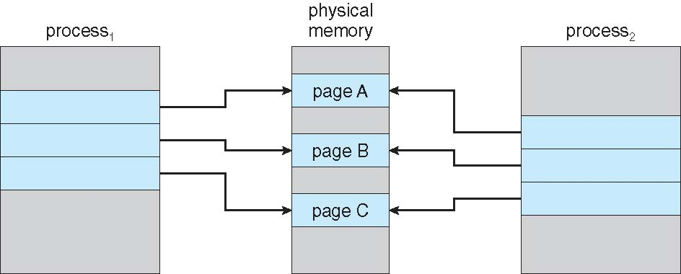
Before Process 1 Modifies Page C

Slide 28
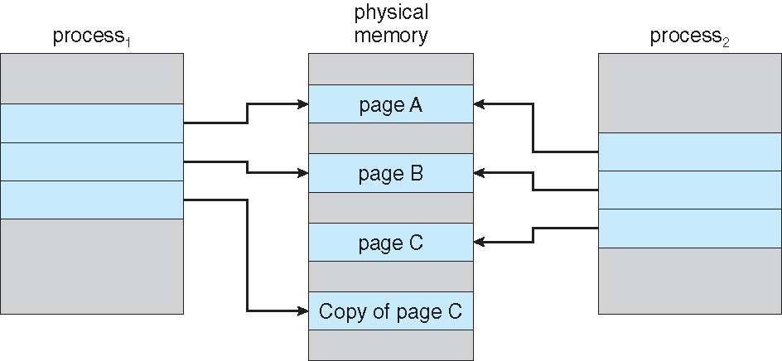
After Process 1 Modifies Page C

Slide 29
Challenges and improvements in implementation
Choice of backing store
  For stack, heap pages: on swap partition
  For code, shared library? : swap partition or the actual executable file on the file-system?
  If the choice is file-system for code, then the page-fault handler needs to call functions related to file-system
Is the page table itself pagable?
  If no, good
  If Yes, then there can be page faults in accessing the page tables themselves! More complicated!
Is the kernel code pagable?
  If no, good
  If yes, life is very complicated ! Page fault in running kernel code, interrupt handlers, system calls, etc.

